Slide 1
Intel SGX Explained 6.2 Memory Access Protection
Seehwan Yoo
Dankook University

Slide 2
Security check - correctness
At all times all the TLB entries in every logical processor will be consistent with SGX＇s security guarantee
Assure that all the memory access by software obey SGX＇s security model
Top-level invariants breakdown
Inv.1: At all times when LP is outside enclave mode, its TLB may only contain physical address belonging to DRAM pages outside PRM
Inv. 2: At all times when LP is inside enclave mode, the TLB entries for virtual address outside the current enclave＇s ELRANGE must contain physical addresses belonging to DRAM pages outside PRM
Inv. 3: At all times when LP is in enclave mode, the TLB entries for VA inside the current enclave＇s ELRANGE must match the virtual memory layout specified by the enclave author

Slide 3
6.3.1 Top-Level Invariant Breakdown
Inv.1: At all times when LP is outside enclave mode, its TLB may only contain physical address belonging to DRAM pages outside PRM
Inv. 2: At all times when LP is inside enclave mode, the TLB entries for virtual address outside the current enclave＇s ELRANGE must contain physical addresses belonging to DRAM pages outside PRM
Inv. 3: At all times when LP is in enclave mode, the TLB entries for VA inside the current enclave＇s ELRANGE must match the virtual memory layout specified by the enclave author
6.3.2 EPCM Entries Reflect Enclave Author Design
6.3.3 TLB Entries for ELRANGE Reflect EPCM Contents
6.3.4 EPCM Entries are Not In TLBs When Modified

Slide 4
6.3.4 EPCM Entries are Not In TLBs When Modified
EPCM entry valid after ECREATE (§ 5.3.1), EADD (§ 5.3.2), EPA (§ 5.5.2), and ELDU / ELDB (§ 5.5).
By those instructions, EPCM becomes valid from invalid
some instructions (EWB, EREMOVE) change valid EPCM to invalid
VA pages, EPC but not assoc with any enclave also have EPCM: only used by microcode, never have TLB entry
EREMOVE invalidates TLB entry when there is no LP in enclave mode
EPCM entry results in TLB translation when LP in enclave mode; when LP is out, TLB is flushed
EWB’s correctness argument is more complex,
as it relies on the EBLOCK / ETRACK sequence to ensure that
any TLB entry that might have been created for an EPCM entry is flushed before the EPCM entry is invalidated.

Slide 5
6.4 Tracking TLB Flushes
This section proposes a straightforward method that the SGX implementation can use to verify that the system software plays its part correctly in the EPC page evic- tion (§ 5.5) process. Our method meets the SDM’s spec- ification for EBLOCK (§ 5.5.1), ETRACK (§ 5.5.1) and EWB (§ 5.5.4).

Slide 6
6.5 Enclave Signature Verification
Let m be the public modulus in the enclave author’s RSA key, and s be the enclave signature. Since the SGX design fixes the value of the public exponent e to 3, verifying the RSA signature amounts to computing the signed message M = s³ mod m, checking that the value meets the PKCS v1.5 padding requirements, and comparing the 256-bit SHA-2 hash inside the message with the value obtained by hashing the relevant fields in the SIGSTRUCT supplied with the enclave.

Slide 7
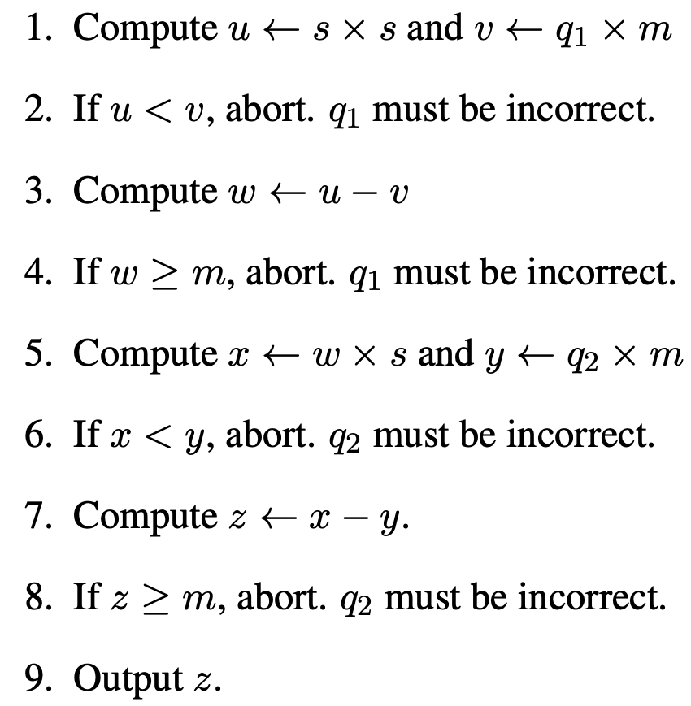
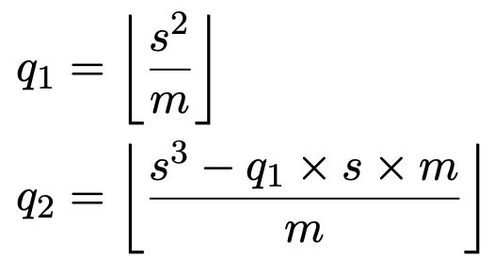
Revised RSA signature verification e=3
Calculate q1, q2
Algorithm for M = s³ mod m

Slide 8
6.6 SGX security properties
6.6.1 Overview
Initial content is loaded by the system software on the computer
Cannot contain secret in plaintext
Once initialized, enclave participate in a software attestation process
authenticate itself to a remote server
Upon successful authentication, the remote server disclose some secret to an enclave over a secure channel
SGX design tries to guarantee that the measurement during software attestation represents the loaded contents in the enclave
Secret migration used to cache the secrets via software attestation in an untrusted storage
Caching reduce the software attestation process
In fact, SGX software attestation is implemented by special privileged enclave
Special enclave use Certificate-based identity system to securely store CPU attestation key in untrusted memory

Slide 9
6.6.2 physical attacks
No open document for hardware SGX implementation
Not trivially circumvent by port attack (such as GDXC breach uncore ring bus data collection/filter)
SGX mem protection impl.
at the core, in PMH,
at the chip die, in the mem cntlr
On-chip cache has plaintext – uncore ringbus traffic: not encrypted
DRAM bus tapping attack
MEE provides confidentiality, integrity, and freshness to EPC data
However, MEE does not protect the address of DRAM when EPC cachelines are evicted or loaded – but not reported yet
SGX doc talks about DRAM bus tapping, but no mention of SystemMgmt bus, SMBus, that connect Intel Mgmt Engine (IME) to various components

Slide 10
SMBus is more accessible than DRAM bus – fewer wires & lower speed
SGX threat model does not include physical attacks on CPU chip
Fused Seal Key, Provisioning Key encrypted with Global Wrapping logic Key (GWK)
E-fuse have a large feature size: easy to pin-point the location in the die using HR microscope
Recent patent tells the CPU employ PUF (physically unclonable function) – asymmetric key generating function
Key gen server encrypts key material with PUF key, and xmits the encrypted material to the chip
Using PUF + GWK makes harder to break GWK
SGX threat model does not include power analysis attacks & other side-channel attacks
expensive countermeasures at the lowest levels of hardware implementation, which can only be designed by engineers who have deep expertise in both system se- curity and Intel’s manufacturing process.

Slide 11
6.6.3 Privileged Software Attacks
The SGX design prevents malicious software from directly reading or from modifying the EPC pages that store an enclave’s code and data. This security property relies on two pillars in the SGX design.
First, the SGX implementation (§ 6.1) runs in the pro- cessor’s microcode (§ 2.14), which is effectively a higher privilege level that system software does not have access to.
SGX’s security checks (§ 6.2) are the last step performed by the PMH, so they cannot be bypassed by any other architectural feature.
Former TXT relied upon VMX; which was unsound because software runs in SMM could bypass VMX
Second, SGX’s microcode is always involved when a CPU transitions between enclave code and non-enclave code (§ 5.4), and therefore regulates all interactions between system software and an enclave’s environment.

Slide 12
6.6.3 Privileged Software Attacks
Second, SGX’s microcode is always involved when a CPU transitions between enclave code and non-enclave code (§ 5.4), and therefore regulates all interactions between system software and an enclave’s environment.
On enclave entry (§ 5.4.1), the SGX implementation sets up the registers (§ 2.2) that make up the execution state (§ 2.6) of the logical processor (LP § 2.9.4), so a malicious OS or hypervisor cannot induce faults in the enclave’s software by tampering with its execution environment.
When an LP transitions away from an enclave’s code due to a hardware exception (§ 2.8.2), the SGX imple- mentation stashes the LP’s execution state into a State Save Area (SSA, § 5.2.5) area inside the enclave and scrubs it, so the system software’s exception handler cannot access any enclave secrets that may be stored in the execution state.
Applies to all privileges, including SMI, AEX events

Slide 13
Reasoning about the security properties of SGX’s transitions between enclave mode and non-enclave mode is very difficult. A correctness proof would have to take into account all the CPU’s features that expose registers.
EENTER (§ 5.4.1) stores the RSP and RBP register values in the SSA used to enter the enclave, but stores XCR0 (§ 2.6), FS and GS (§ 2.7) in the non-architectural area of the TCS (§ 6.1.3).
this approach would break the Intel architecture’s guarantees that only system software can modify XCR0, and application software can only load segment registers using selectors that index into the GDT or LDT set up by system software.
Specifically, a malicious application could modify these privileged registers by creating an enclave that writes the desired values to the current SSA locations backing up the registers, and then executes EEXIT (§ 5.4.2).
About Hyper-Threading, SGX does not prevent hyper-threading, so malicious system software can schedule a thread executing the code of a victim enclave on an LP that shares the core with an LP executing a snooping thread.

Slide 14
Mitigation for HT-attacks
cloud computing providers to disable hyper-threading when offering SGX.
The SGX enclave measurement would have to be extended to include the computer’s hyper-threading configuration, so the remote parties in the software at- testation process can be assured that their enclaves are hosted by a secure environment.
having the SGX implementation guarantee that when an LP is executing an enclave’s code,
the other LP sharing its core is either inactive,
or is executing the same enclave’s code.

Slide 15
6.6.4 Memory Mapping Attacks
The SGX design protects the code inside enclaves against the active attacks described in § 3.7. These protections have been extensively discussed in prior sections, so we limit ourselves to pointing out SGX’s answer to each active attack.
Passive attacks reasons about enclave mem access pattern at 4KB pg gran.
EPCM has EPC page’s position in its enclave’s virtual address space.
prevent straightforward active address translation attacks (§ 3.7.2) by rejecting undesirable address translations before they reach the TLB (§ 2.11.5).
EPC can be evicted to untrusted DRAM
When system software wishes to evict EPC pages, it must follow the process described in § 5.5.1, which guarantees to the SGX implementation that all the LPs have invalidated any TLB entry associated with pages that will be evicted. This defeats the active attacks based on stale TLB entries described in § 3.7.4.

Slide 16
Passive attack example
malicious OS kernel or hypervisor can obtain the page-level trace of an application executing inside an enclave by setting the present (P) attribute to 0 on all the enclave’s pages before starting enclave execution.
While an enclave executes, the malicious system software maintains exactly one instruction page and one data page present in the enclave’s address space.
When a page fault is generated, CR2 contains the virtual address of a page accessed by enclave, and the error code indicates whether the memory access was a read or a write (bit 1) and whether the memory access is a data access or an instruction fetch access (bit 4).
the kernel tracing the enclave code’s memory access pattern would set the P flag of the desired page to 1, and set the P flag of the previously accessed data page to 0.
For a slightly more detailed trace, the kernel can set a desired page’s writable (W) attribute to 0 if the page fault’s error code indicates a read access, and only set it to 1 for write accesses.

Slide 17
Leaving an enclave via an Asynchronous Enclave Exit (AEX, § 5.4.3) and re-entering the enclave via ERESUME (§ 5.4.4) causes the CPU to flush TLB en- tries that contain enclave addresses, so a tracing kernel would not need to worry about flushing the TLB.
The tracing kernel does not need to flush the caches either, because the CPU needs to perform address translation even for cached data.
A straightforward way to reduce this attack’s power is to increase the page size, so the trace contains less information. However, the attack cannot be completely prevented without removing the kernel’s ability to over-subscribe the EPC, which is a major benefit of paging.

Slide 18
6.6.5 Software Attacks on Peripherals
attacks described in § 3.6, which can be carried out by the system software thanks to its ability to control peripheral devices on the computer’s motherboard (§ 2.9.1).
(MC, § 2.11.3) integrated on the CPU chip die to reject any DMA transfer that falls within the Pro- cessor Reserved Memory (PRM, § 5.1) range.
This protects against software attacks on DRAM’s integrity, like the rowhammer attack described in § 3.6.2.
The SDM describes an array of measures that SGX takes to disable processor features intended for debug- ging when a LP starts executing an enclave’s code.
For example, enclave entry (§ 5.4.1) disables Precise Event Based Sampling (PEBS) for the LP, as well as any hard- ware breakpoints placed inside the enclave’s virtual ad- dress range (ELRANGE, § 5.2.1).
SGX does not protect against software side-channel attacks that rely on performance counters.

Slide 19
Documentation that is publicly available from Intel does not provide enough information to model the information leakage due to performance counters.
For example, Intel does not document the mapping implemented in CBoxes (§ 2.11.3) between physical DRAM addresses and the LLC slices used to cache the addresses. This mapping impacts several uncore performance counters, and the impact is strong enough to allow security researches to reverse-engineer the mapping [85, 135, 197].
The SGX papers mention that SGX’s threat model includes attacks that overwrite the flash memory chip that stores the computer’s firmware, which result in malicious code running in SMM.
§ 3.6.4 states that the ME’s firmware is stored in the same flash memory as the boot firmware, and enumerates some of ME’s special privileges that enable it to help system administrators remotely diagnose and fix hardware and software issues.
§ 3.6.4 argues that an attacker who compromises the ME can carry out actions that are usually classified as physical attacks.
Therefore, an ME compromise would be equivalent to the DRAM attacks analyzed in § 6.6.2.

Slide 20
lack of documentation on the ME’s implementation
For example, the ME is involved in the computer’s boot process (§ 2.13, § 2.14.4), so it is unclear if it plays any part in the SGX initialization sequence.
Furthermore, during the security boot stage (SEC, § 2.13.2), the bootstrap LP (BSP) is placed in Cache-As-Ram (CAR) mode
so that the PEI firmware can be stored securely while it is measured.
This suggests that it would be convenient for the ME to receive direct access to the CPU’s caches,
so that the ME’s TPM implementation can measure the firmware directly.
At the same time, a special access path from the ME to the CPU’s caches might sidestep the MEE, allowing an attacker who has achieved ME code execution to directly read the EPC’s contents.

Slide 21
6.6.6 Cache Timing Attacks
The SGX threat model excludes the cache timing attacks
The SGX documentation bundles these attacks together with other side-channel attacks and summarily dismisses them as complex physical attacks.
However, cache timing attacks can be mounted entirely by unprivileged software running at ring 3.
The main difference between SGX and a standard architecture is that SGX’s threat model considers the system software to be untrusted.
As explained earlier, this accurately captures the situation in remote computation scenarios, such as cloud computing. SGX’s threat model implies that the system software can be carrying out a cache timing attack on the software inside an enclave.
A malicious system software translates into signifi- cantly more powerful cache timing attacks, compared to those described in § 3.8. The system software is in charge of scheduling threads on LPs, and also in charge of set- ting up the page tables used by address translation (§ 2.5), which control cache placement (§ 2.11.5).

Slide 22
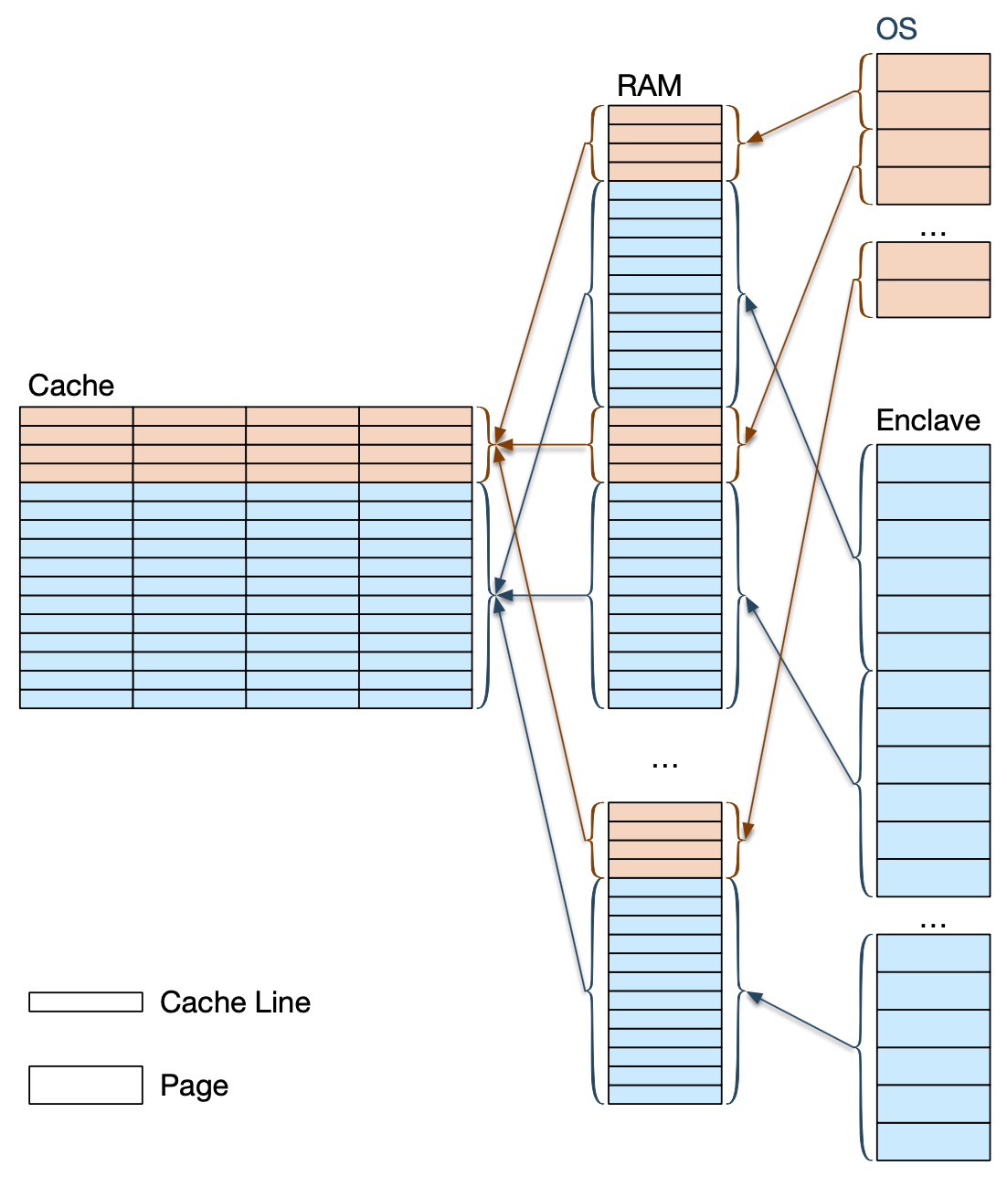
Example attack scenario
For example, the malicious kernel set out to trace an enclave’s memory access patterns described in § 6.6.4 can improve the accuracy of a cache timing attack by using page coloring [117] principles to partition [129] the cache targeted by the attack.
divides the cache’s sets (§ 2.11.2) into two regions, as shown in Figure 94.
On a system with an Intel CPU, the the OS can partition the L2 cache by manipulating the page tables in a way that is completely oblivious to the enclave’s software.

Slide 23
The system software stores all the victim enclave’s code and data in DRAM addresses that map to the cache sets in one of the regions, and stores its own code and data in DRAM addresses that map to the other region’s cache sets. The snooping thread’s code is assumed to be a part of the OS. For example, in a typical 256 KB (per- core) L2 cache organized as 512 8-way sets of 64-byte lines, the tracing kernel could allocate lines 0-63 for the enclave’s code page, lines 64-127 for the enclave’s data page, and use lines 128-511 for its own pages.

Slide 24
there is no minor modification to SGX that would provably defend against cache timing attacks. However, the SGX design could take a few steps to increase the cost of cache timing attacks.
For example, SGX’s enclave entry implementation could flush the core’s private caches, which would prevent cache timing attacks from targeting them.
Barring the additional protection measures described above, a tracing kernel can extend the attack described in § 6.6.4 with the steps outlined below to take advantage of cache timing and narrow down the addresses in an application’s memory access trace to cache line granularity.
Right before entering an enclave via EENTER or ERESUME, the kernel would issue CLFLUSH instructions to flush the enclave’s code page and data page from the cache.
The tracing kernel then uses 16 bogus pages (8 for the enclave’s code page, and 8 for the enclave’s data page) to load all the 8 ways in the 128 cache sets allocated by enclave pages.

Slide 25
An extreme approach that can provably defeat cache timing attacks is disabling caching for the PRM range, which contains the EPC.
SGX manuals that it is based on state that the allowable caching behav- iors (§ 2.11.4) for the PRM range are uncacheable (UC) and write-back (WB).

Slide 26
6.6.7 Software Side-Channel Attacks and SGX
§ 5.8 explains that, in fact, the SGX design delegates the creation of attestation signatures to software that runs inside a Quoting Enclave with special privileges that allows it to access the processor’s attestation key. Re- stated, SGX includes an enclave whose software reads the attestation key and produces attestation signatures.
Creating the Quoting Enclave is a very elegant way of reducing the complexity of the hardware implementation; However, the security analysis in § 6.6 reveals that enclaves are vulnerable to a vast array of software side-channel attacks, which have been demonstrated effective in extracting a variety of secrets from isolated environments.
SGX designers will advise developers to write their code in a way that avoids data-dependent memory accesses, as suggested in § 3.8.4, and perhaps provide analysis tools that detect code that performs data-dependent memory accesses.
The main drawback of the approach described above is that it is extremely cumbersome. § 3.8.4 describes that, while it may be possible to write simple pieces of software in such a way that they do not require data- dependent memory accesses, there is no known process that can scale this to large software systems. For example, each virtual method call in an object-oriented language results in data-dependent code fetches.

Slide 27
The ISCA 2015 SGX tutorial slides also suggest that the efforts of removing data-dependent memory accesses should focus on cryptographic algorithm implementations, in order to protect the keys that they handle. This is a terribly misguided suggestion, because cryptographic key material has no intrinsic value. Attackers derive benefits from obtaining the data that is protected by the keys, such as medical and financial records.
Unfortunately, it is easy to lose track of the fact that keys are being attacked simply because they are the lowest hanging fruit.
A system that can only protect the keys will have a very small positive impact, as the attackers will simply shift their focus on the algorithms that process the valuable information, and use the same software side-channel attacks to obtain that information directly

Slide 28
The second drawback of the approach described to- wards the beginning of this section is that while eliminating data-dependent memory accesses should thwart the attacks described in § 6.6.4 and § 6.6.6, the measure may not be sufficient to prevent the hyper-threading attacks described in § 6.6.3.
The level of sharing between the two logical processors (LP, § 2.9.4) on the same CPU core is so high that it is possible that a snooping LP can learn more than the memory access pattern from the other LP on the same core.
For example, if the number of cycles taken by an integer ALU to execute a multiplication or division micro- op (§ 2.10) depends on its inputs, the snooping LP could learn some information about the numbers multiplied or divided by the other LP. While this may be a simple example, it is safe to assume that the Quoting Enclave will be studied by many motivated attackers, and that any information leak will be exploited.

